Slide 1

Forces Introduction – Mar 13
(Unit 3: Dynamics – Day 01)
Agenda
  Marks, Mid-Term, etc.
    Kinematics Unit Test – Plan
    Newton's Laws Review Sheet
    Inclined Plane ISU Assignment
  2D Net Force
    Discussion: Dynamics Net Force PDF
    Samples: Pulling a Sled & Inclined Plane
Upcoming
  Due when we get back (April 5?)
    Circular Motion Lab
    Newton’s Laws Review Sheet
    Inclined Plane ISU Assignment

Slide 2
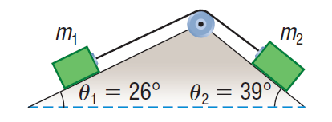
Inclined Plane ISU Assignment
Due When We Get Back
  Newton's Laws Review Sheet
  Fully worked solution FOR THIS

